Slide 1

Bachelor Thesis 2
Mechanistic Study of CO₂ methanation over Ru/TiO₂
Arghadeep Biswas
21CH30049
Under the supervision of
Dr. Koustuv Ray
Department of Chemical Engineering
Indian institute of Technology, Kharagpur

Slide 2

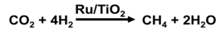
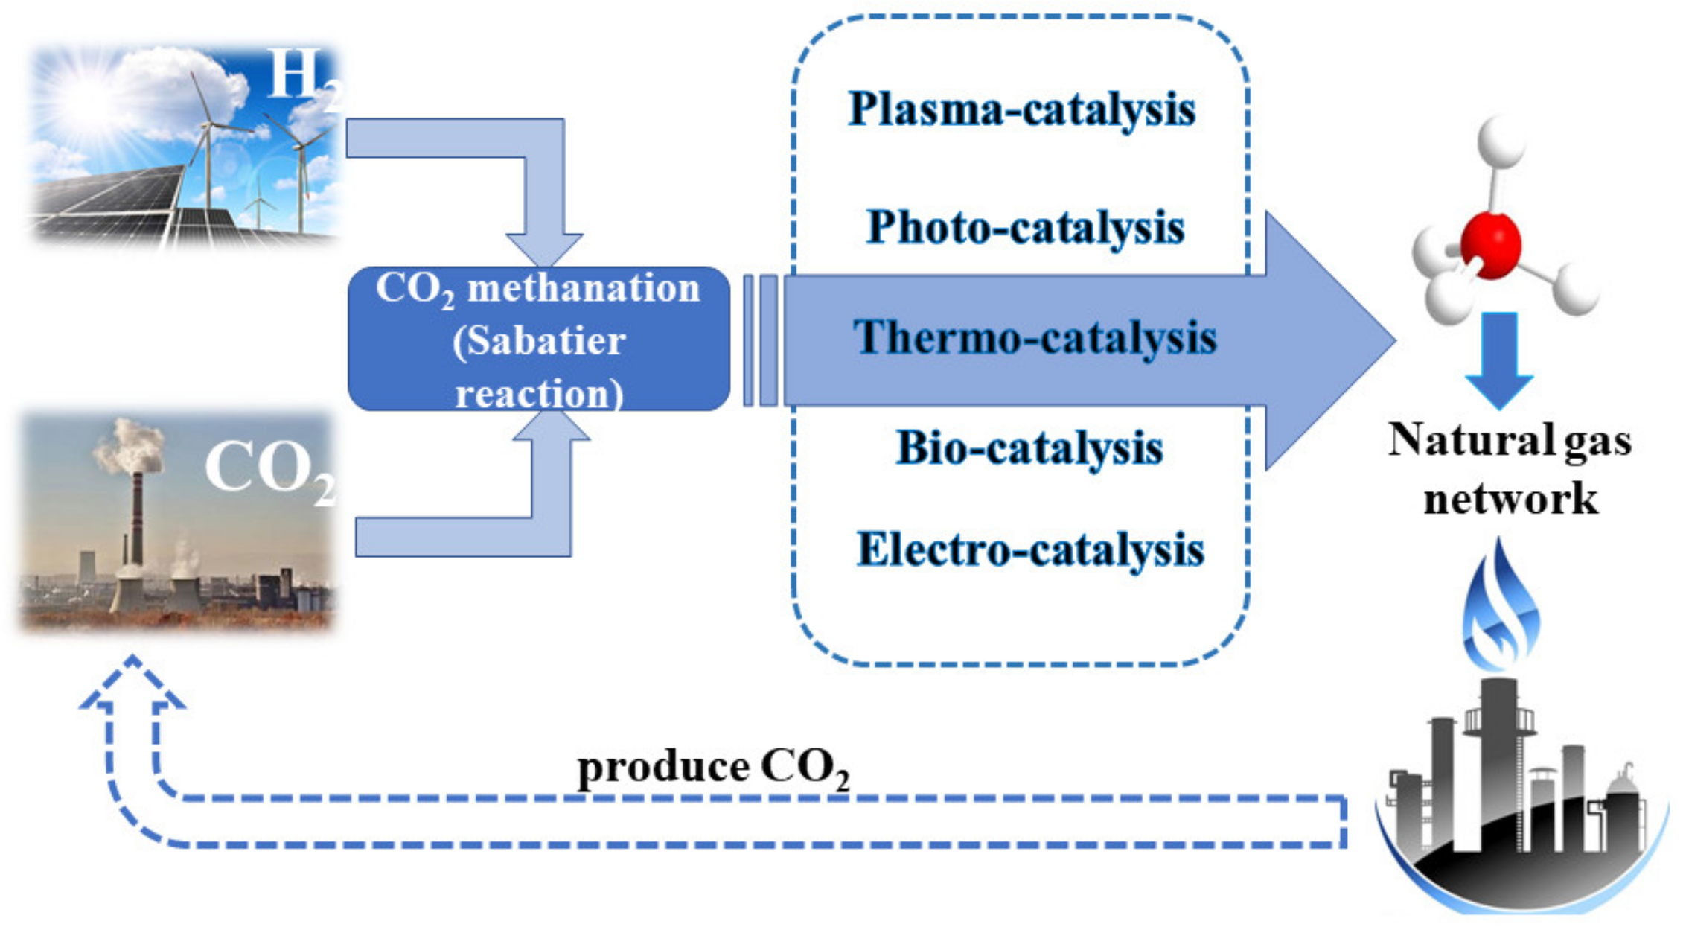
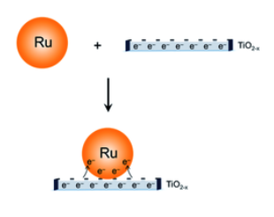
.
CO₂ Methanation and Adsorption on Ru/TiO₂
CO₂ Methanation – A Key Utilization Route
Hydrogenation of CO₂ to CH₄ (Sabatier reaction) is a promising method for CO₂ utilization.
Reaction is viable under mild conditions and produces CH₄ suitable for direct use or storage.
CH₄ can be transported using existing natural gas infrastructure.
Fig. 1: CO₂ hydrogenation to produce CH₄ via different catalysis methods (Li Li et. al.) [1]
Fig. 2 : Ruthenium on Titanium Dioxide support (Y. Zhang, et al.) [2]
Catalytic Focus: Ru/TiO₂
Ru/TiO₂ stands out for high CH₄ selectivity and activity under low temperatures.
TiO₂ supports (anatase, rutile, Degussa P25) enhance activity via electronic interactions.
Reverse Water-Gas Shift (RWGS) reaction provides CO as an intermediate for methanation.
Hydro
Notes:
NASA and JAXA are also working on life support systems for closed-space environments where CO₂ methanation is necessary to maintain human operations [7]. In addition to methane, CO₂ hydrogenation can also yield useful chemicals such as methanol (CH₃OH), formaldehyde (HCHO), ethanol (C₂H₅OH), dimethyl ether (CH₃OCH₃), and higher hydrocarbons and oxygenates, providing fossil fuel alternatives

Slide 3

Objective
CO₂ Methanation Performance Study CO₂ methanation over Ru/TiO₂ by varying temperature (150–400°C) and time (at 300°C) to determine optimal reaction conditions.
CO₂ Adsorption Behavior Analyze CO₂ adsorption on Ru/TiO₂ across temperatures (150–400°C) and at 200°C over time to understand surface intermediates and their stability.
In-situ DRIFTS Analysis Use in-situ DRIFTS to identify surface species formed during methanation and adsorption processes.
Reaction Pathway Correlation Correlate catalytic activity with surface coverage to propose potential reaction mechanisms.

Slide 4
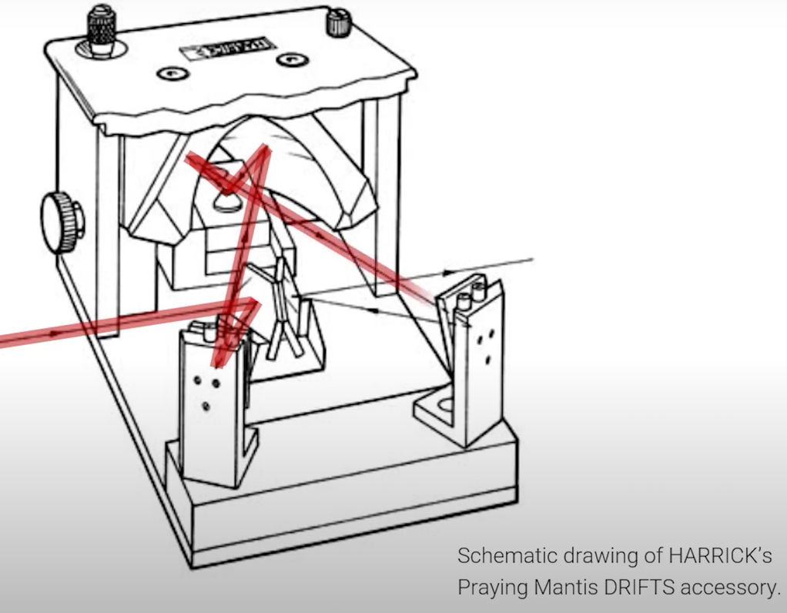
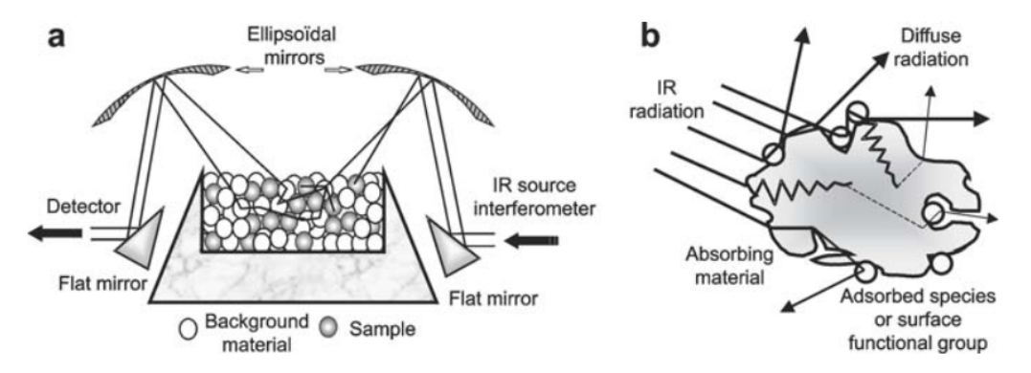
DRIFTS | Diffuse Reflectance Infrared Fourier Transform Spectroscopy
The Harrick Praying Mantis
Where is Drifts used? How does it work?
Sample Properties:
Rough surfaces
Powders
Application examples:
Development of catalysts
Study temperature effects
Monitoring of reaction kinetics
Characterization of soil samples
Schematic drawing of Praying Mantis DRIFTS Cell
Fig 3.
a Scheme of the diffuse reflectance accessory
b Course of the infrared radiation through an heterogeneous absorbing material [3]
IR bean coming from the spectrometer is focused and directed at the sample
The sample diffusely scatters the incoming IR beam
The mirrors collect the scattered light and directed back to the spectrometer’s detector

Slide 5
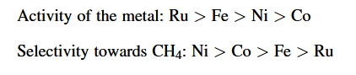
Literature Review
Catalyst Screening for CO₂ Methanation
Catalyst | T (◦ C) | X CO2 (%) | S CH4 (%) | Ref.
2% wt. Ru/ TiO₂ | 250ºC | 20 | 100 | (Panagiotopoulou ,2017) [4]
3% wt. Ru/ Al₂O₃ | 300ºC | 96 | 96 | (Garbarino et al., 2015) [5]
4% wt. Ru/ Al₂O₃ | 375ºC | 85 | 100 | (Quindimil et al., 2015) [6]
1% wt. Ru/ 15% wt. Ni/ Al₂O₃ | 400ºC | 88 | 82 | (Al and Al, 2020) [7]
Key Active Phases and Supports
Metals Studied: Ni, Co, Fe, Ru, Rh
Supports Used: SiO₂, Al₂O₃, CeO₂, TiO₂, ZrO₂, and mixed oxides
Advantages
High Activity and CH₄ selectivity
Effective at low temperatures
Enhanced with optimized support choice
Table1: Supported Ru-based catalyst for CO₂ methanation. H₂/CO₂ ratio of 4 ; X CO₂ = conversion of CO₂ ; S CH₄ = selectivity to CH_{4.} All the samples were prepared by impregnation of the metal over the support
Notes:
In a valuable study, Xu et al. (2016) examined the influence of TiO₂ as a support material. The Ru/TiO₂ catalyst demonstrated over three times the methanation rate of Ru/Al₂O₃. This improvement was linked to the smaller average Ru particle size (2.8 nm compared to 4.3 nm), which was promoted by the rutile form of TiO₂. The presence of this stable crystalline phase effectively limits particle agglomeration and enhances metal dispersion, contributing to the increased activity.

Slide 6
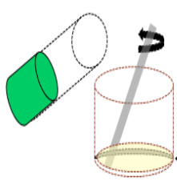
METHODOLOGY
Catalyst Preparation
RuCl₃·xH₂O solution
Precursor
Pressed into pellets, crushed and sieved(150-200µm)
Catalyst | Ru Loading | Key properties
1 wt% Ru/TiO₂ | Moderate | Balanced activity and dispersion; Common in methanation
3 wt% Ru/TiO₂ | High | Higher activity, but risk of sintering
5 wt% Ru/TiO₂ | Very High | Higher CO conversion, but possible drop in selectivity
Pretreated Support
Heated in an oil bath at 323K to evaporate all the solvent
Placed in an oven and dried at 378K over night
Calcination at 473K(4h) and cooled to room temperature
Fig 4: Schematic for catalysts synthesis using incipient wetness impregnation method
Washed with dilute ammonia and water(3times each)

Slide 7
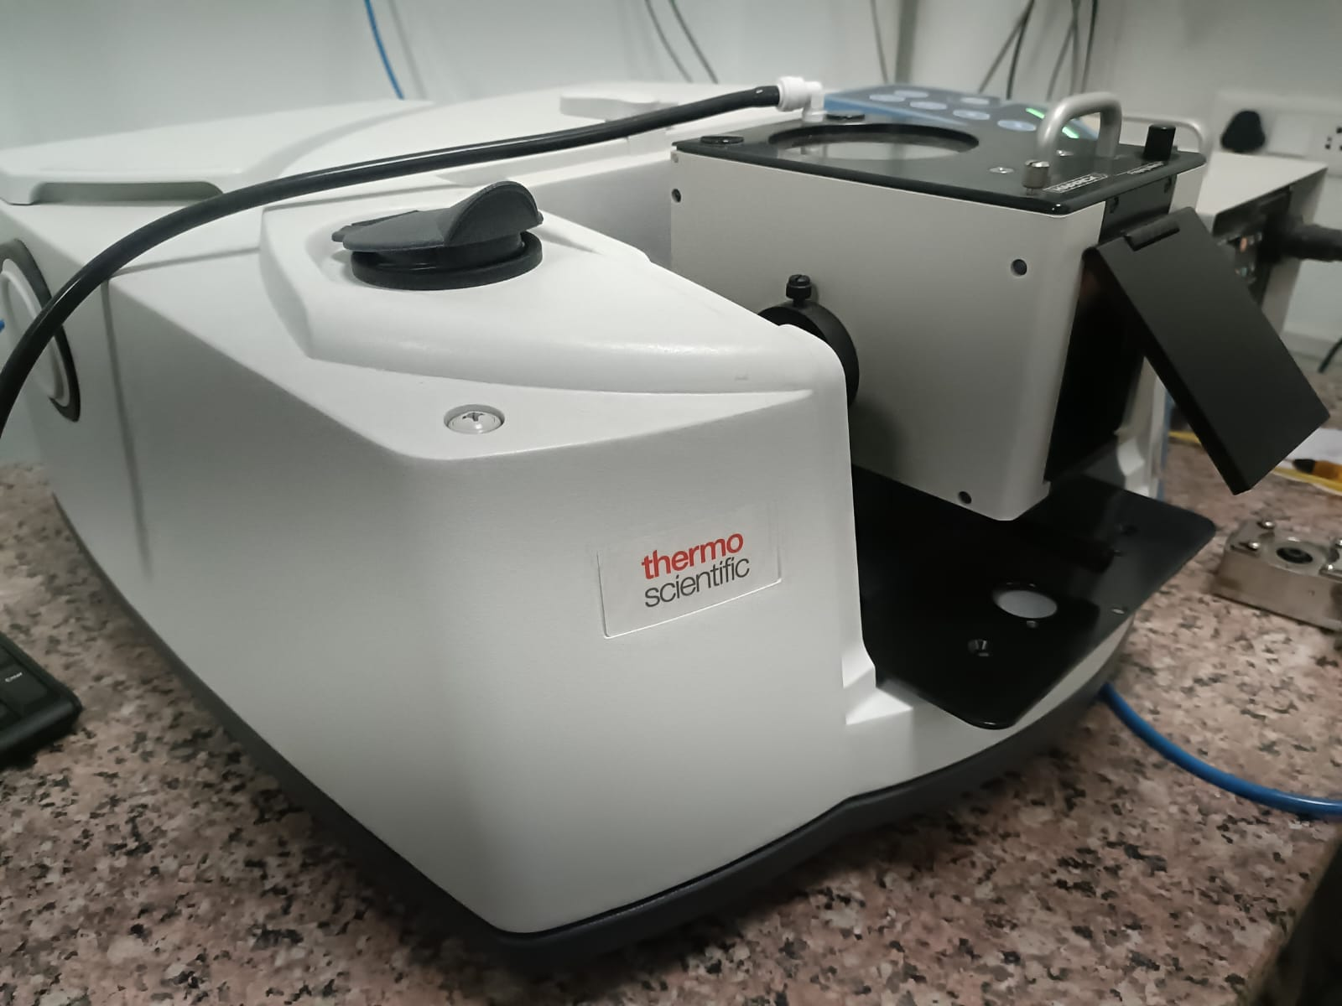
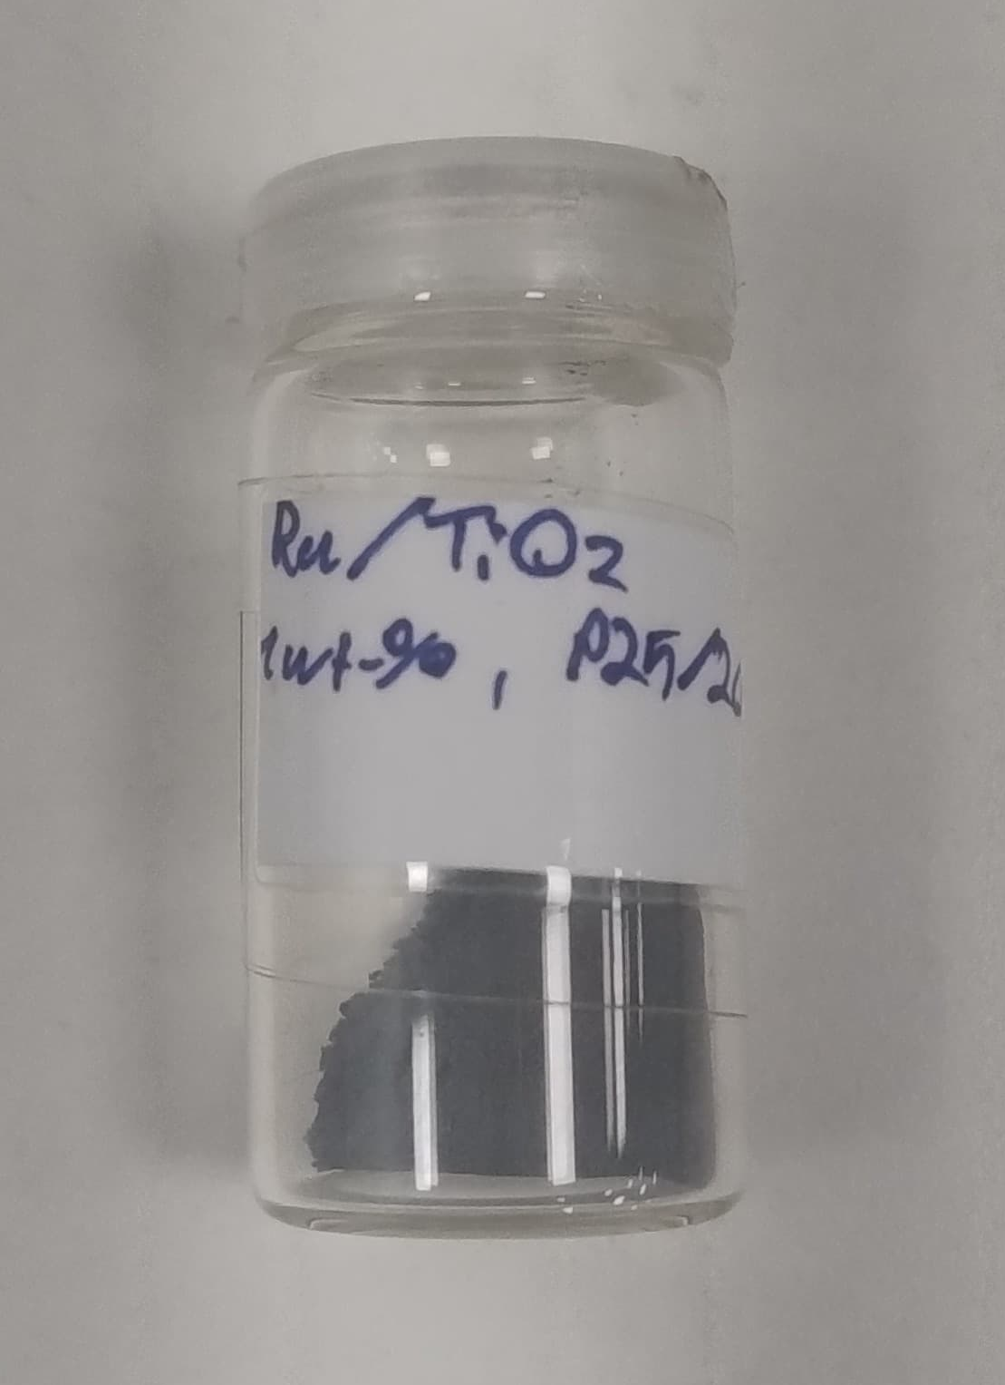
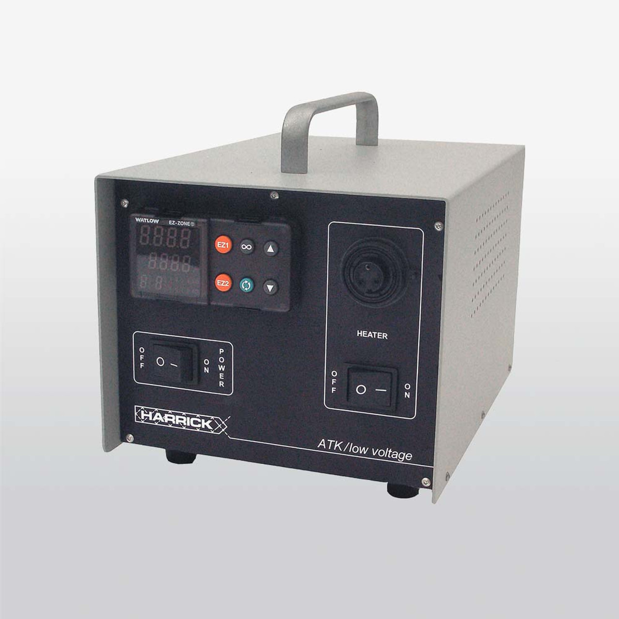


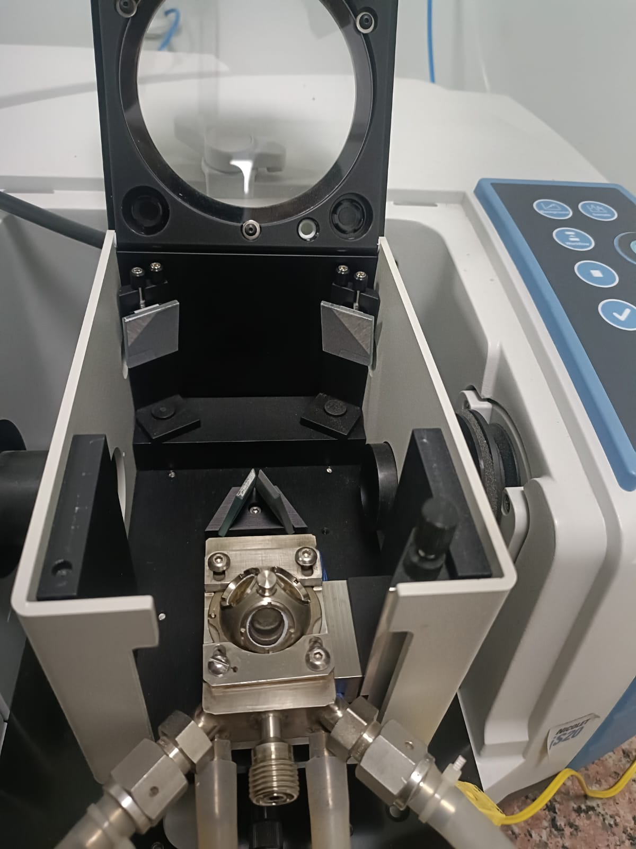
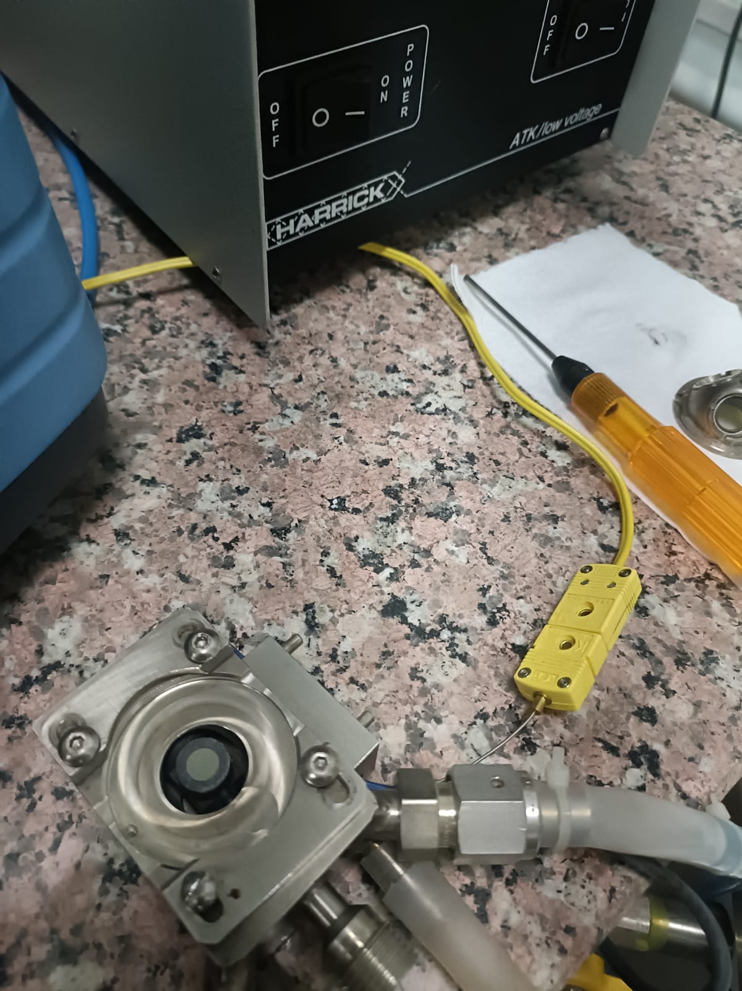

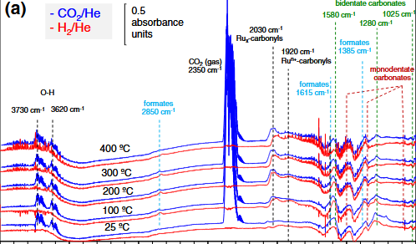
METHODOLOGY CONT.
EXPERIMENTAL SET-UP
Temperature Controller
CO₂
Valves
H₂
He
MFC
Spectrometer
Pipelines
Thermocouple attached to TC
Placing the reaction chamber onto the praying mantis apparatus
Display Output
Loading the catalyst onto the reaction chamber
Flow Out
Chiller out
Chiller in
Flow in
Fig 5: Schematic of the Experimental Set-up

Slide 8
METHODOLOGY CONT.
EXPERIMENTAL PROCEDURE for Ru/TiO₂
Catalyst Preparation
Catalyst Reduction
He Purge
Background Spectrum Collection
Load 1 wt% Ru/TiO₂ catalyst into the DRIFTS (Praying Mantis) reaction cell.
Reduce at 250 °C for 3.5 hours under H₂. MFCs calibrated for H₂ and He.
Purge system with He for 30 minutes to remove residual gases.
Cool to 50 °C, introduce liquid nitrogen, and collect background spectra.
CO₂ Methanation
Methanation Preparation
Post-Adsorption Purge
CO₂ Adsorption
Introduce CO₂ + H₂ at 150-400 °C. Time-dependent methanation study at 300 °C for 1 hour
Re-calibrate MFCs for CO₂ and H₂ flow.
Purge with He for 30 minutes to clear surface.
Introduce CO₂ at 150-400°C (50 °C intervals) and also collected spectra at 200ºC for 1 hour

Slide 9
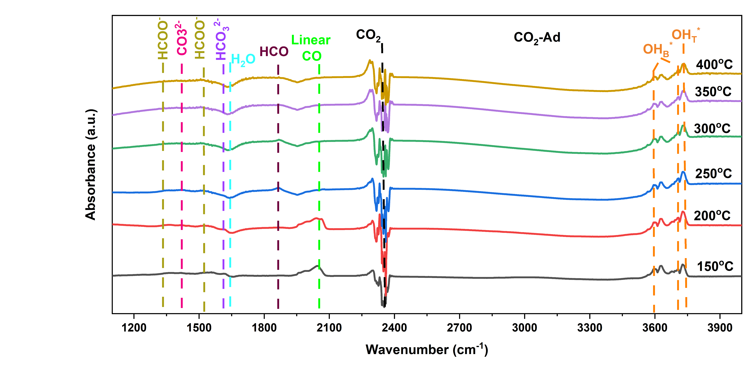
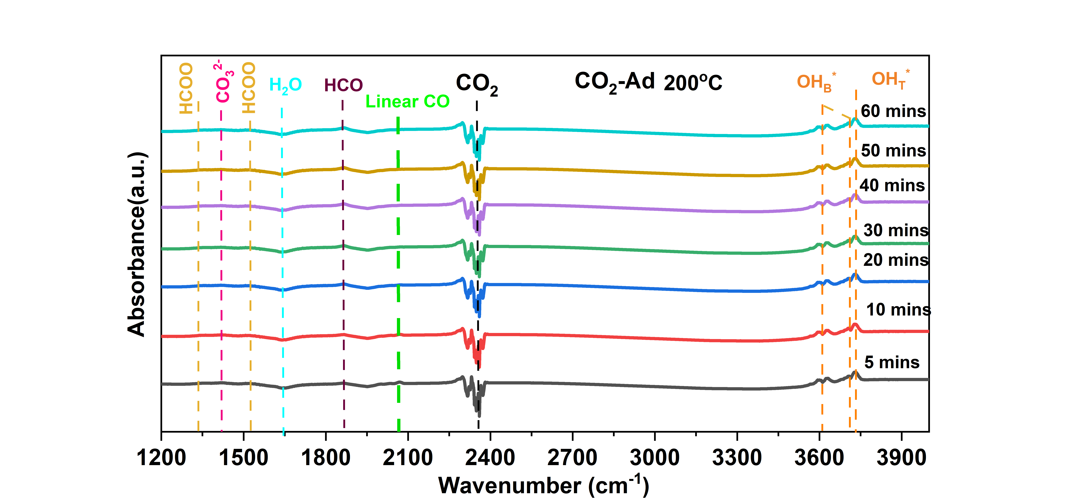
RESULTS & DISCUSSION – CO₂ ADSORPTION
Fig 8: in-situ DRIFT spectra during CO₂ adsorption over 1 % Ru/TiO₂
Fig 9: in-situ DRIFT spectra during CO₂ adsorption at 200ºC for 1 hour
Key Observations
Formation of bicarbonate (HCO₃⁻) species observed at 1612 cm⁻¹. Hydroxyl band gradually decreases
HCO₃⁻ bands disappear. Simultaneous emergence of HCOO⁻ species
Maximum absorption observed at 200ºC

Slide 10
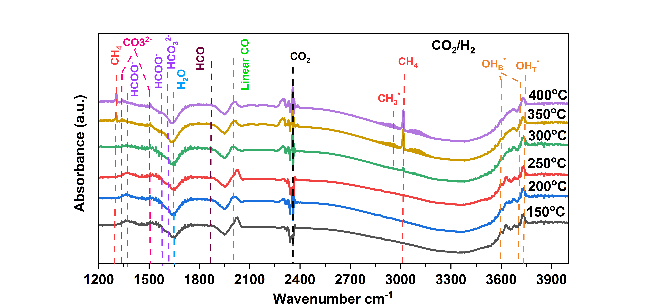
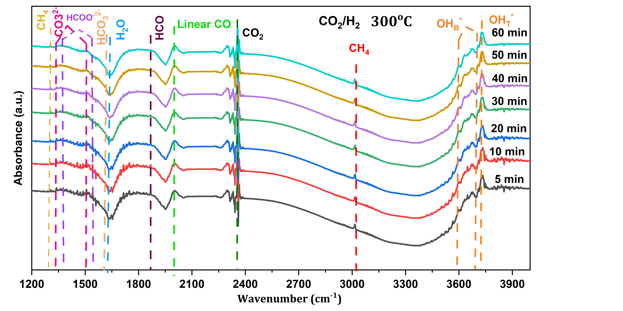
RESULTS & DISCUSSION - CO₂ METHANATION
Fig 6: in-situ DRIFT spectra during CO₂ methanation over 1 % Ru/TiO₂
Fig 7: in-situ DRIFT spectra during CO₂ methanation at 300C for 1 hour
Key Observations
The bands of CH₄ at 1304 and 3017 cm⁻¹ are present with the bands of CH₃*(2960) and HCOO*(1369 and 1573 cm⁻¹)
HCO₃⁻ bands(1623 cm⁻¹) disappear at 200 °C, replaced by HCOO⁻ (1369, 1573 cm⁻¹) → maximum at 300 °C.
CO spikes suddenly when HCO₃⁻ vanishes indicating a secondary CO route

Slide 11
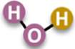
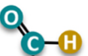


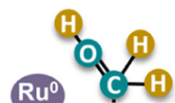

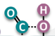
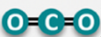
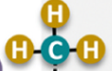

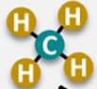
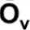

FORMATE PATHWAY
CO₂(g)
Followed at lower temperatures
TiO₂
CO₂*
H*
HCO₃*
H*
TiO₂
TiO₂
H* + H*
H*
HCOO*
H*
CH*
TiO₂
TiO₂
H*
TiO₂
CH₃*
H*
Fig 10: Proposed formate pathway for CO₂ methanation over 1% Ru/TiO₂ catalysts
CH₄(g)

Slide 12

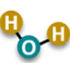


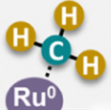

RWGS + CO Methanation pathway
Followed at Higher temperatures
CO₂(g)
TiO₂
CO₂*
H*
H*
TiO₂
TiO₂
HCO₃*
HCOO*
H* + H*
H*
CO*
H*
TiO₂
TiO₂
CH₃*
H*
TiO₂
CH₄(g)
Fig 11: Proposed RGWS + Methanation pathway for CO₂ methanation over 1% Ru/TiO₂ catalysts

Slide 13
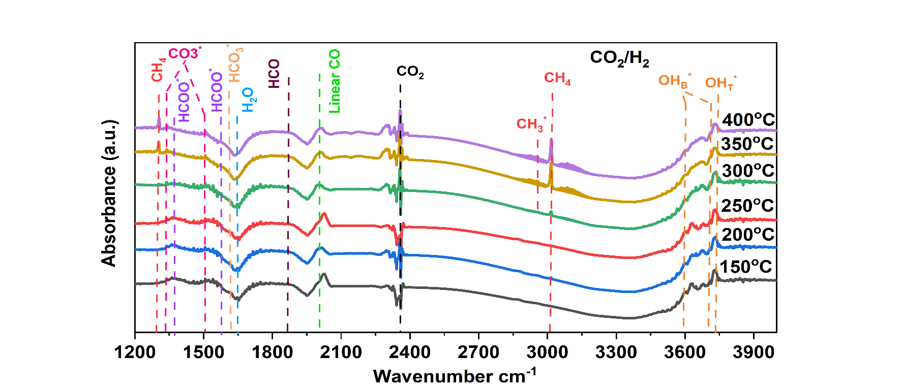
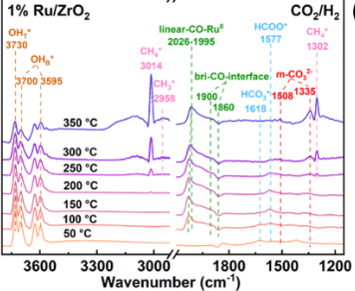
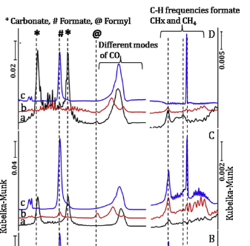
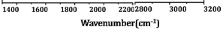
Comparison with Other Supports
Fig 12: Ru/TiO₂
Fig 13: Ru/ZrO₂ (M. Liu et al.) [8]
Ru/Al₂O₃(P. Dongapure. et al.) [9]
HCO₃²⁻ forms at ~ 150ºC
HCOO⁻ dominates 200-300ºC
Weak CO bands emerge only at > 300ºC
Intense HCO₃⁻ formation
Strong HCOO⁻ Peaks at 200 º C
Presence of Bridged CO bands confirm CO intermediates
Carbonate peaks (1435 & 1652 cm⁻¹ ) seen at 175ºC.
Strong CO bands (1850-2100cm⁻¹).
Back donation of the metal to CO antibonding orbitals on adsorption.
Weaker formate activity, CO pathway at higher temperature
Fastest, most efficient formate route (OH- rich)
Dominant CO pathway

Slide 14
CONCLUSION
Temperature Dependency
Lower Temperature: Formate Pathway observed (150ºC-250ºC), Formation of bicarbonates and formates
Higher Temperature: Appearance of CH₄ bands (from 350ºC onwards) and decline in CO-related bands
Time Dependency
At fixed temperatures (300 °C for methanation, 200 °C for adsorption), spectra remained time-invariant.
Ru/ZrO₂ : Strong formate-route preference
Ru/Al₂O₃: Favors CO hydrogenation
Ru/TiO₂ : Dual Pathway (Formate at lower temperature + CO at higher temperature)
Support Comparison

Slide 15
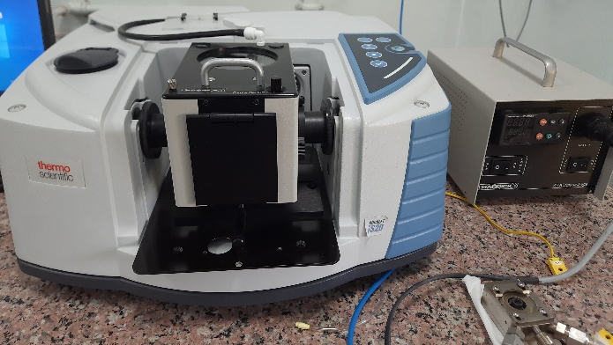



Future Prospect
Activity along with mechanistic pathways findings
WP-1 Synthesis of catalysts, followed by drifts characterisation
k_{g} = f(k_{i} , k_{a} , k_{e})
Intrinsic (k_{i})
WP-2 Effect of Temperature, Pressure, Flow rate and Promoters on TOF/Rate/Conversions by activity tests along with in-situ FTIR
Global rate model
Apparent (k_{a})
Extrinsic (k_{e})
K_{g} = f(T, P, N_{Re}, N_{Pr}, N_{Sc}, N_{Sh}, catalyst, reactor geometry)
IWI
EDX, TEM, Chemisorption
WP-3 Kinetic modelling followed by validation of experimental activity study (from WP-2)
WP-4 CFD reaction model development of the developed model using Ansys Chemikin-Pro / COMSOL Multiphysics

Slide 16
REFERENCES
Research Progress and Reaction Mechanism of CO2 Methanation over Ni-Based Catalysts at Low Temperature: A Review, Li LI et al.
Strong metal–support interaction of Ru on TiO2 derived from the co-reduction mechanism, Y. Zhang et al.
Diffuse Infrared Fourier Transform Spectroscopy in Environmental Chemistry, Azambre, et al.
Hydrogenation of CO₂ over supported noble metal catalysts, Panagiotopoulou et al.
Methanation of carbon dioxide on Ru/Al₂O₃ and Ni/Al₂O₃ catalysts at atmospheric pressure: Catalysts activation, behaviour and stability, Garbarino et al.
Effect of metal loading on the CO₂ methanation: A comparison between alumina supported Ni and Ru catalysts, Quindimil et al.
Improving CO₂ methanation performance by distributed feeding in a Ni-Mn catalyst fixed bed reactor, Aldea et al.
Improvement in the activity of Ru/ZrO2 for CO2 methanation by the enhanced hydrophilicity of zirconia, Liu et al.
Variations in activity of Ru/TiO 2 and Ru/Al2O3 catalysts for CO2 hydrogenation: An investigation by in-situ infrared spectroscopy studies, P. Dungapure et al.

Slide 17





Q&A

